Slide 1
What Are Our Rights?

Slide 2
Table of Contents
Needs vs. Wants Video
2. Read Aloud: I Have the Right to Be a Child
3. United Nations Explained? Video (expands on human rights)
4. Reflect & Journal - Human Rights
5. Stop & Talk About It - Human Rights
Educators:
- Guide students through the above content & activities in order to provide them with a basic understanding of human rights and the rights of children.
- Provide relatable examples for students as you see fit to help them make connections to the concepts of needs and rights. This provides a foundation for future lessons on inequality and environmental racism.

Slide 3
Needs vs. Wants
Educators:
- Play the video & be ready to pause so that students can answer questions & participate in the game at the end.
- Provide relatable examples for students as you see fit to help them make connections to the concepts of needs and wants. They may need to work through more examples to understand the difference.

Slide 4
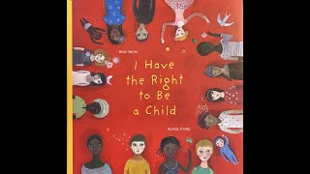
Read Aloud:
I Have the Right to Be a Child
Educators:
- Preview the video before sharing it with your students so that you are ready to answer any questions they may have.
- Provide relatable examples for students as you see fit to help them make connections to the concepts of human needs, human rights, and the rights of a child. They may need to work through more examples to understand this concept. (Link to full Convention on the Rights of a Child from the UN for educators.)

Slide 5
United Nations Explained
Educators:
- Preview the video before sharing it with your students so that you are ready to answer any questions they may have.
- Provide relatable examples for students as you see fit to help them make connections to the concept of human rights. They may need to work through more examples to understand fully.

Slide 6
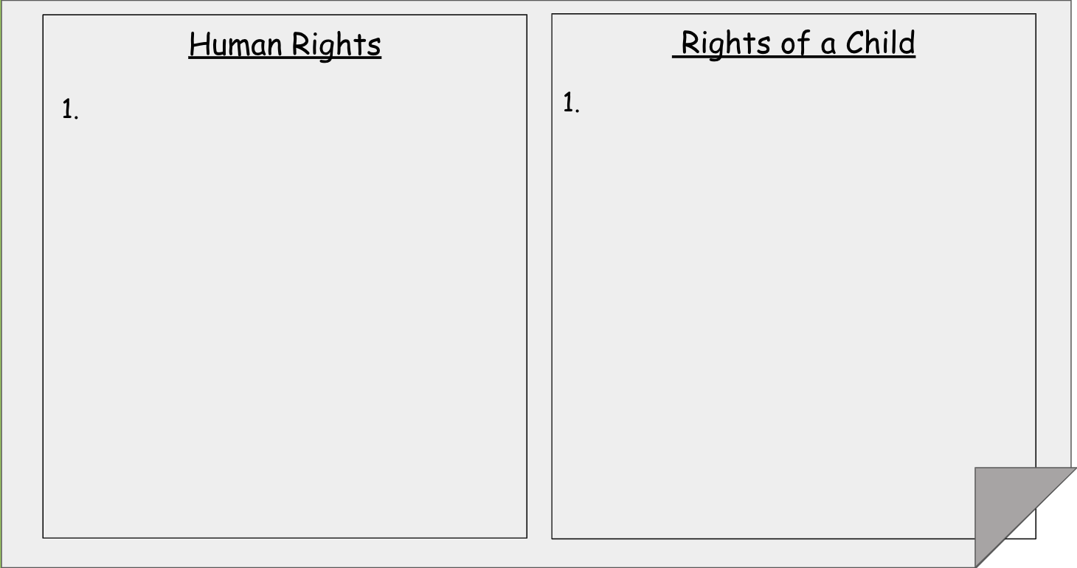
Reflection & Journal
Educators:
- Ask students to think about the videos you watched and help you remember the rights that they have as children and the rights all people have. (Emphasize for them that ALL people have these rights.)
- Make a list of their answers on chart paper or in the document above (it’s linked to make a copy of a Google Doc for you). Students can choose to copy one or all into their journal and draw a picture to illustrate their understanding of what this right looks like in their life.

Slide 7
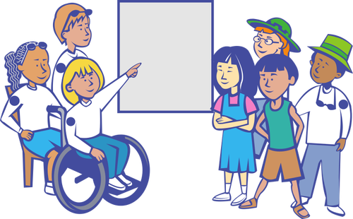
Stop & Talk About It
Things You Can Share:
Tell your partner about what you drew in your picture.
Tell your partner an example of something you need & something you want.
Try to answer this question with your partner: Should all people have the food, water, shelter, safety, and other things they need to live?
Educators:
- Give your students a chance to share their learning by sharing their illustrations with peers and talking about what they learned today about their rights. Circulate to check in and help clarify any misconceptions.
- Students can also be given the opportunity to share their learning with families and friends by uploading a picture of their work to whichever digital portfolio or sharing platform your school uses.

Slide 8
References & Resources:
BuzzWithBee. (2020, November 29). Needs and Wants for Kids [Video]. YouTube. Retrieved March 20, 2023, from https://www.youtube.com/watch?v=6OAqNtueu0U
CBC Kids News. (2019b, March 26). United Nations - explained l CBC Kids News [Video]. YouTube. Retrieved March 20, 2023, from https://www.youtube.com/watch?v=SaAmfiJtV4I
Friends of Simon Wiesenthal Center. (2020, October 29). Human Rights Story Corner: I Have the Right to Be a Child [Video]. YouTube. Retrieved March 20, 2023, from https://www.youtube.com/watch?v=ERKhP7bQ6Os

