Slide 1
Right to a Healthy Environment

Slide 2
Table of Contents
Right to a Healthy Environment video
2. What is Pollution? video
3. Reflect & Journal: Healthy vs. Unhealthy
4. Does everyone have a healthy environment? video
5. Make a Poster: Healthy Environments
6. Stop & Talk About It - Healthy Environments
Educators:
- Guide students through the above content & activities in order to provide them with a basic understanding of the right all people have to a clean & healthy environment.
- Provide relatable examples for students as you see fit to help them make connections to the concepts of healthy environments and human rights. This provides a foundation for future lessons on inequality and environmental racism.

Slide 3
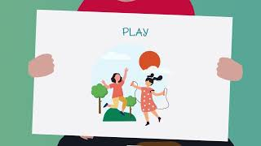
Right to a Healthy Environment
Before moving to the next slide, ask students to brainstorm answers to this question:
What can make an environment an unhealthy place to live?
- Preview the video before sharing it with your students so that you are ready to answer any questions they may have.
- Provide relatable examples for students as you see fit to help them make connections to the concept of a healthy environment. They may need to work through more examples to understand fully.

Slide 4
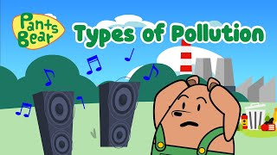
What is Pollution?
- Preview the video before sharing it with your students so that you are ready to answer any questions they may have.
- Provide relatable examples for students as you see fit to help them make connections to the idea of pollution. They may need to work through more examples to understand fully.

Slide 5
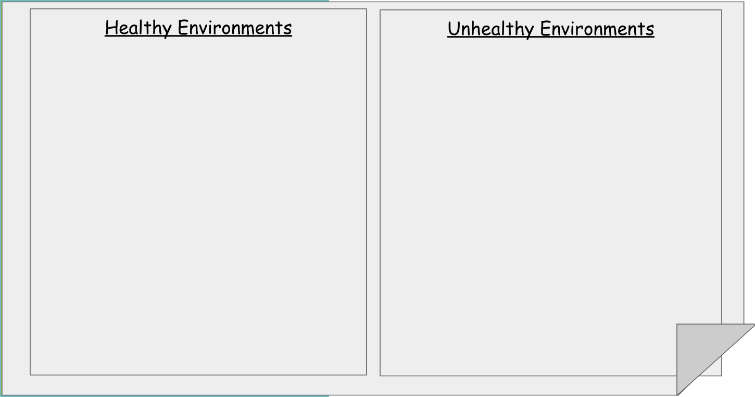
Brainstorm: Healthy/Unhealthy
Educators:
- Ask students to think about the videos you watched and help you remember what a healthy environment looks like and what an unhealthy environment looks like.
- Make a list of their answers on chart paper or in the document above (it’s linked to make a copy of a Google Doc for you). Students can choose to copy one or all into their journal and draw a picture to illustrate their understanding of what healthy and unhealthy environments are.

Slide 6
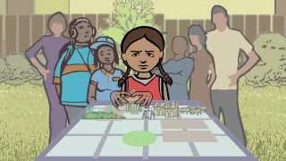
Does everyone have a healthy environment?
- Preview the video before sharing it with your students so that you are ready to answer any questions they may have.
- Provide relatable examples for students as you see fit to help them make connections to the idea that not all people have the option to live in a healthy environment, even if it is their right as a human being.
- Ask students questions about the differences they notice between the two neighbourhoods.

Slide 7
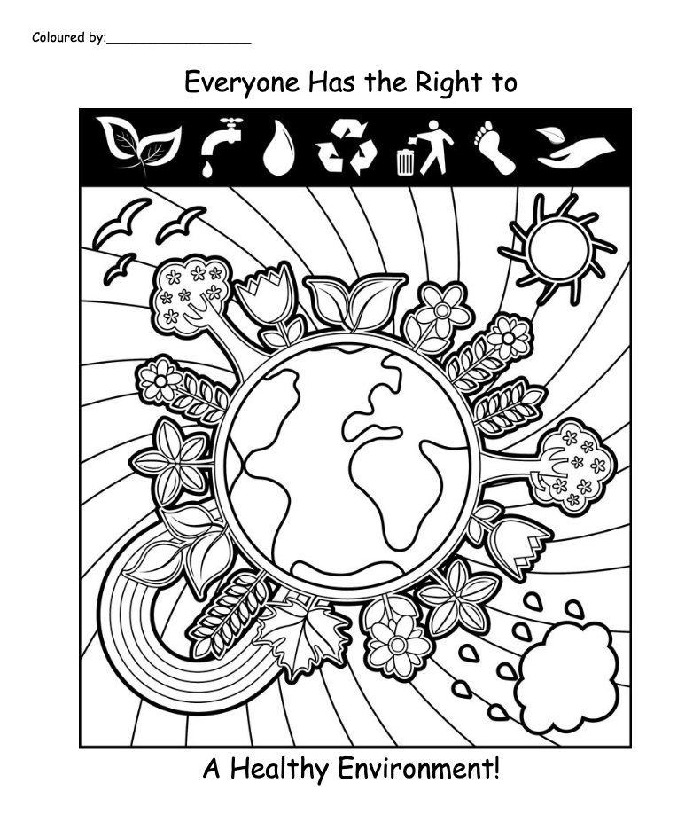
Create a Poster
Adapted from: https://coloringhome.com/
Students can create a poster to share their learning about healthy environments and human rights.
They may draw their own illustration and add text to let people know that a healthy environment in a right we all have, OR you can print off the linked colouring page above for them to colour, if needed.

Slide 8
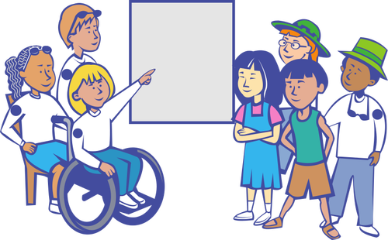
Sharing Our Learning
Things You Can Share:
Tell your partner about what you drew in your journal or poster picture.
Tell your partner an example of what healthy and unhealthy environments are like.
Try to answer this question with your partner: Do you think it’s fair that some people can’t live in a healthy environment, even though it is a human right?
Educators:
- Give your students a chance to share their learning by sharing their illustrations with peers and talking about what they learned today about healthy environments. Circulate to check in and help clarify any misconceptions.
- Students can also be given the opportunity to share their learning with families and friends by uploading a picture of their work to whichever digital portfolio or sharing platform your school uses.

Slide 9
References & Resources:
Center for Earth Energy and Democracy. (2015, November 2). What is Environmental Justice? [Video]. YouTube. Retrieved March 22, 2023, from https://www.youtube.com/watch?v=5hOJ-VosFI0
OHCHR Asia. (2022, May 30). Children’s Rights to a Healthy Environment in the ASEAN Region. [Video]. YouTube. Retrieved March 22, 2023, from https://www.youtube.com/watch?v=2VLjNe7IO0g
Pants Bear Kids - Cartoons. (2023, February 7). Pollution | Types of Pollution | Science for kids | #Pantsbear [Video]. YouTube. Retrieved March 22, 2023, from https://www.youtube.com/watch?v=LYVwbB2-tnE

