Slide 1
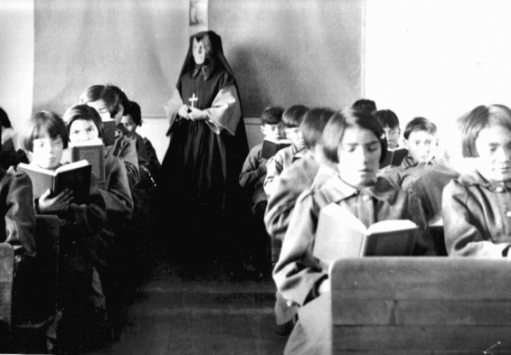
First Peoples of Canada & Racism
Students of Fort Albany Residential School in Class
(Source: Edmund Metatawabin collection at the University of Algoma)

Slide 2
Table of Contents
The Roots of Racism in Canada (video)
2. Truth - Chief Robert Joseph’s Experience (video)
3. Reflect & Respond
4. What is Reconciliation (video)
5. Stop & Talk About It - Racism & First Peoples
- Click on the different sections above and watch the videos to learn the truth of the history of Canada and ways to work toward equity in the treatment of marginalized groups like the Indigenous peoples of Canada.

Slide 3
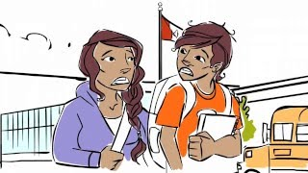
The Roots of Racism in Canada
- Watch the video on this slide about the history of racism in Canada towards Indigenous people.
As you watch, think about:
Why did colonizers think it was okay to treat other human beings the way they treated Indigenous peoples? How does it make you feel?
What can you do as a young person to make changes to the racism that still exists in Canada?

Slide 4
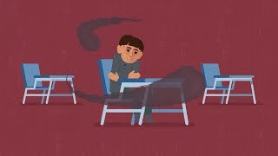
Truth - Chief Robert Joseph’s Experience
- Watch this video to hear Chief Robert Joseph’s story and the first steps toward reconciliation in Canada.
- Indigenous people of Canada have been marginalized and mistreated for hundreds of years. We need to learn the truth of the history of Canada, understand that Indigenous people are still to this day not treated with equity in Canada, and learn what we can do to help make changes through reconciliation.
As you watch, think about:
Why do you think it’s important to learn the truth of how Indigenous people were treated?
Have you heard of other groups of people in Canada who have been mistreated because of their race, culture, or religion? How did that make you feel?

Slide 5
Reflect & Respond
Take a moment to think about the videos you just viewed and the questions asked on the last two slides.
Click on the image of the Padlet screen above. It will take you to a Padlet where you can share what you’ve learned or what you still wonder about the history of racism and Indigenous people in Canada. (Click on the plus sign below the question you want to respond to and type in your answer.)
Remember to be respectful in your choice of words.

Slide 6
What is Reconciliation?
Watch the video on this slide and pay attention to the meaning of reconciliation and the calls to action (found here).
While you watch, think about:
What are the calls to action & have they all been addressed, or does more still need to be done?
What are some ways that are mentioned that you can make a difference? What are some ideas of your own?

Slide 7
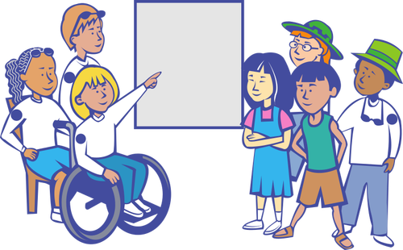
Stop & Talk About It:
Tell your partner what you learned about the history of racism in Canada.
Tell your partner an example of something that has been done to work toward reconciliation so far.
Try to answer this question with your partner: Do you think that racism, discrimination, & mistreatment toward Indigenous peoples of Canada still exists today? What evidence do you have from what you learned today?
Ask your partner: What can you do to make a positive difference in how Indigenous people and other marginalized groups are treated in Canada?
This is a Stop and Talk slide. Your teacher will help you find a partner. Sit facing your partner and take turns talking about the topics above.
Be respectful and polite.
Give examples from the videos you watched today to support your answers.
Ask questions if you need more information to understand your partner’s idea (eg. “Can you tell me more about that?”)

Slide 8
References & Resources:
CBC. (2017, December 18). Namwayut: we are all one. Truth and reconciliation in Canada | Canada is . . . [Video]. YouTube. Retrieved March 25, 2023, from https://www.youtube.com/watch?v=2zuRQmwaREY
CBC Kids News. (2021, September 27). What is reconciliation? | CBC Kids News [Video]. YouTube. Retrieved March 25, 2023, from https://www.youtube.com/watch?v=WEj5vjc2EDk
Indigenous Youth Wellness. (2016, March 17). The Roots of Racism [Video]. YouTube. Retrieved March 25, 2023, from https://www.youtube.com/watch?v=7h9CBMDlb0w

